Slide 1
Pakistan – HIV Outbreak Response
Saqib Ali Shaikh,
Deputy Manager Sindh AIDS Control Program

Slide 2
Pakistan- Increase in new HIV infections
2010-2017
India
Indonesia
Myanmar
Malaysia
Pakistan
Thailand
Viet Nam
Philippines
Source: Prepared by www.aidsdatahub.org based on UNAIDS 2018 HIV Estimates

Slide 3


Pakistan- Epidemic at a Glance - 2010 -2017
2017
Trend
(2010-2017)
% change
New HIV infections distribution by population
PLHIV
150,000
2010
2017
New HIV infections
20,000
45%
People who inject drugs
Transgender
Men who have sex with men
AIDS-related deaths
6,200
377%
Male sex workers
Female sex workers and clients
Partners of key populations
HIV prevalence among key populations, national and subnational (%)
21%
Kasur, 50.8%
5.5%
Larkana, 18%
3.7%
Karachi, 9.2%
2.1%
Sukkur, 8.8%
Source: www.aidsdatahub.org based on Global AIDS Monitoring 2017
Reporting; UNAIDS 2018 HIV Estimates (preliminary results); and IBBS

Slide 4
HIV Outbreaks in Pakistan - 2003-2019
Kot Imrana. Sargodha, Punjab
n = 669
Unsafe injection
* Purple = Peer-reviewed publications, White = Media reports,
Larkana, Sindh
n = 17
Injecting drug use
Jalalpur Jattan, Gujrat, Punjab
n = 88
Unsafe injection
Larkana, Sindh
n = 56
Dialysis unit
Larkana, Sindh
n = 955 ?
Chiniot, Punjab
n = 42
DG Khan, Punjab
n = 2,798?
Source : NACP & SACP

Slide 5
HIV Prevalence in the Population of Larkana District
HIV Prevalence Measure | Prevalence | Source
High-risk populations ¹ | Transgender 18.2% IDU 16.2% MSM 4.9% FSW 4.1% | 2017 IBBS
General population | - | None
Pregnant women | - | ANC Clinics
TB patients | 1.5% - 1.8% | TB Clinic, Larkana
Thalassemia Patients | 9% | Thalassemia Clinic, Larkana
Blood donors² | 0.04% to 0.3% | Blood Donor Testing Logs
IDU, Injection Drug Use; MSM, Men-who-have-sex-with-men; FSW, Female Sex Worker
Eight blood banks in Larkana and Sukkur RBC

Slide 6
Pakistan – HIV Outbreak at Ratodero, Larkana 2019
3rd of April
Unusually high number of recurrently sick children aged 7m-8y visited by a local GP
Sample were sent to the SACP Referral Lab at Larkana,
5 confirmed HIV+ by RDT (ages 9m-8y)
Voluntary HIV Screening of General Pop. at Ratodero
In support of district & health administration
Parents Screened
No one was found to be HIV positive
12 children resulted HIV positive.
The RDT kits were not WHO approved
Note: Strongly suspected & and shared by media that transmission occurred because of unsafe medical procedure
(e.g. injections, IV drips) and procedure offered by untrained HC practitioner(s).

Slide 7
Modified Screening Algorithm
HIV testing
Test 1: Alere Determine
HIV testing performed differently in different sites and across time, based upon testing availability
Reactive
Non-reactive
Test 2: SD Bioline
Negative
Reactive
Non-reactive
Test 3: Alere Combo
Repeat both test 1 & 2
Reactive
Non-reactive
Confirmed positive
Repeat test 1, 2, 3 after 14 days

Slide 8
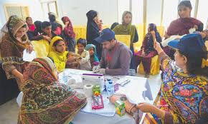
HIV testing
Lack of confidentiality and counselling
Testing occurs with many people in the room
Media cameras video filming, taking photos, listening, etc....
No counselling provided: patients seemed confused about their result
Community feedback shows that people do not understand HIV and are confused about what to do next
Picture copied from www.pakistantoday.com.pk

Slide 9
Individuals Screened and Reactive for HIV by RDT Larkana, Ratodero - 25 Apr - 15 July 2019

Slide 10
Summary - Screening Data, 23 July 2019
Total Screened | 30, 518
Total HIV +ve | 956
 | 173 Adult | 783 Children
Total Registered for Treatment *as on 23 july2019 | 854
 | 136 Adult | 718 Children
Total on Treatment *as on 23 July 2019 | 693
 | 131 Adult | 562 Children
Source: Screening Data, Ratodero & HIV Treatment Center (Adult & Pediatrics) Larkana

Slide 11
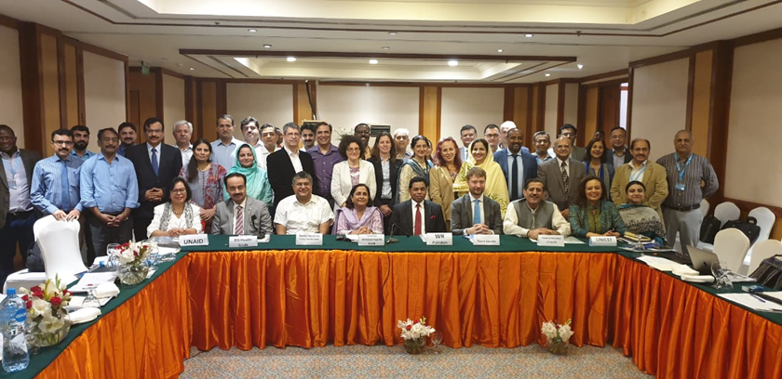
WHO Mission in Response to HIV Outbreak
  WHO Mission - International experts on HIV visited Larkana for around 04 weeks
  Investigation was carried out in 04 different directions to assess:
  Epidemic
  Treatment and Testing
  Infection Prevention
  Community response

Slide 12
Findings of WHO Mission 1
Iatrogenic transmission via unsafe injection practices and poor infection control practices in clinics & hospitals is likely to be the most important driver of the outbreak
Transmission from mothers, high-risk groups, or traditional community practices do not explain this outbreak
Other sources of infection, such as blood transfusions, may have contributed to the number of cases
Further investigation needed such as Phylogenetic / genomic analysis, case control study, HIV recency testing & Population-based household survey in Ratodero

Slide 13
Efficacy of HIV Transmission from injecting equipment
HIV transmission efficiency
  0.5% to 3% for injections with small- to large-bore needles
  10% to 20% for procedures such as maintaining IV lines, phlebotomy
IV and IM injections can be potential source
  Blood in the syringe’s “dead space” and in the needle
  Virus may remain viable more than a month at 22°C and for a week at 32 °C
Notes:
Experimental contamination of syringes with 25-50 μL of infected blood, infective HIV virus remained:
in 2 of 4 syringes after 3 water flushes;
in 2 of 4 syringes virus after 3 hours and 12 water flushes
in 1 of 4 syringes after flushing with full-strength household bleach (5.25% sodium hypochlorite)

Slide 14
Iatrogenic Outbreaks Reported in the Literature in Countries Other than Pakistan [N=8]
Country | Year | Population | Likely Exposures | Cases
Mexico | 1986-1988 | Plasma donors | Plasma collection equipment | 281
India | 1987-1989 | Plasma donors | Plasma collection equipment | 82
Russia | 1988-1989 | Children | IV lines, intramuscular injections | >260
Romania | 1989 | Children | Injections, other | >1000
Egypt | 1990-1991 | Dialysis patients | Dialysis equipment | 82
Colombia | 1992-1993 | Dialysis patients | Dialysis equipment | 13
Libya | 1997-1999 | Children | IV lines, other | >400
Cambodia | 2014-2015 | General Population | Injections | 242

Slide 15
Acute care hospitals – Preparation of injectables
Notes:
Exposed needles and sharps were observed in patient wards.

Slide 16
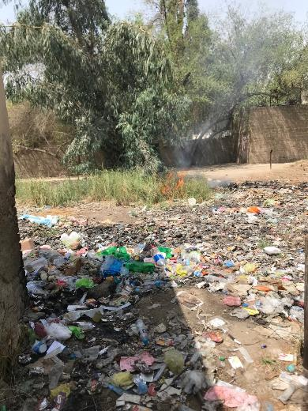
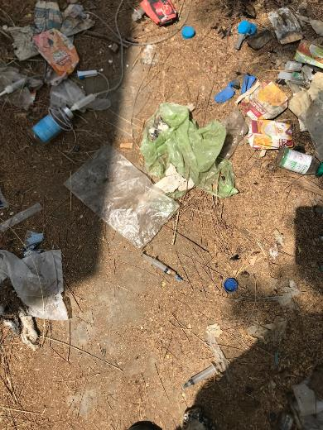
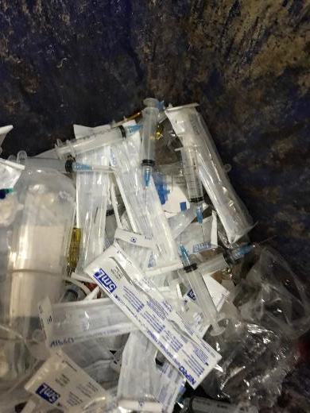
Acute care hospitals – Waste “management”
Notes:
Proper waste management is not in place in any of the facilities.

Slide 17

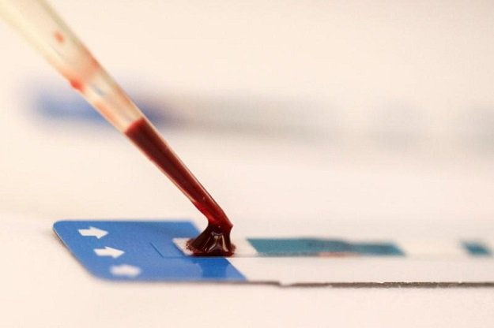
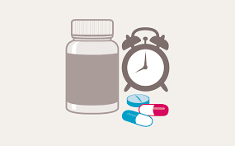


HIV Outbreak Response
Government
  Mobilization of Stakeholders
  District administration, Public Health Programs, Local Partners, UN Agencies, Authorities, Health Commission & Academia
  Media Sensitization
  Resource Mobilization (RDTs, ARVs, HR, Equipment, Govt. Funds)
Screening
Voluntary Screening Camp to Test HIV at Ratodero , Larkana
Treatment
  Establishment of 02 HIV Treatment Center, Pediatrics at Larkana & at Ratodero
  Registration & Initiating Treatment to HIV +ve
Investigation
  Preliminary Investigation by FELTP (Gov. Organization)
  Detail Investigation by Aga Khan University
Infection Prevention
Control
  Assessment of IPC Practices & Waste Disposal

Slide 18
Action Response Plan
Epidemiology
Improved electronic screening registration
Dedicated Dash Board for HIV in the existing M&E system
Rountin ANC screening
Case Control Study (MOH/SACP/AKU)
Treatment and Care
Sustainable human resource
Sustainable supply of RDTs, cd4, VL testing capacity and ARV
Retraining and M&E
Infection Prevention
Safe blood Provision and Implementation of Disposable Syringe Act 2010
Hospital Waste Disposal
Hospital ICCs
Development of Infection Control Training Module for HCPs

Slide 19
Action Response Plan
Community Engagement
Development of Communication Strategy
Review and modify existing IC Material (visual and audio)
Address gender based violence at community level
Gatekeepers within community
  Lady Health Workers
  School Teachers
  Village elders
  Religious Elders
  Local Politicians and influential elders

Slide 20
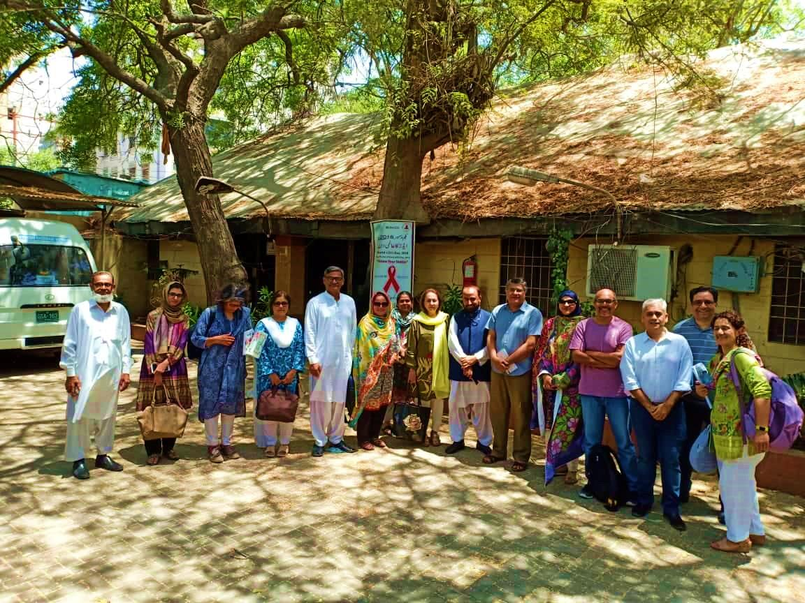
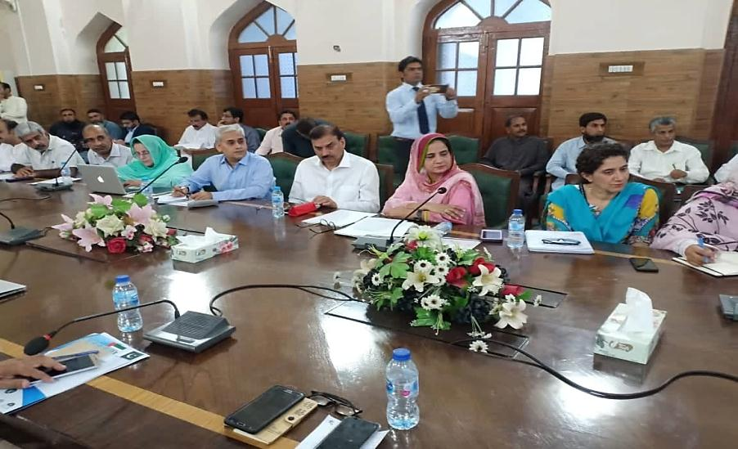
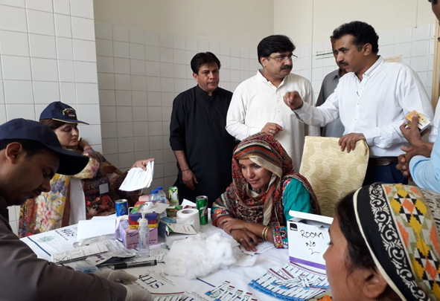
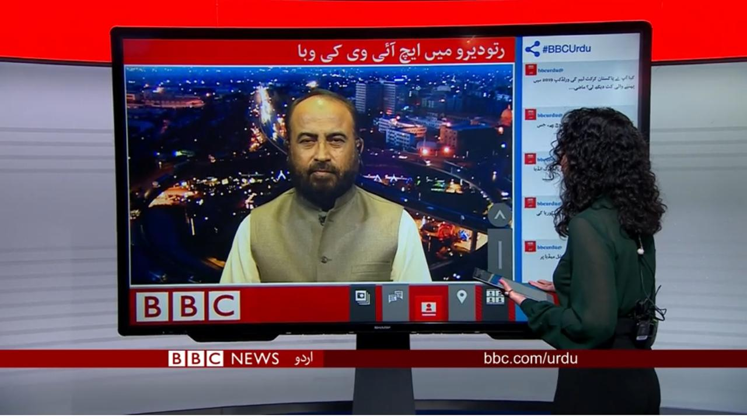
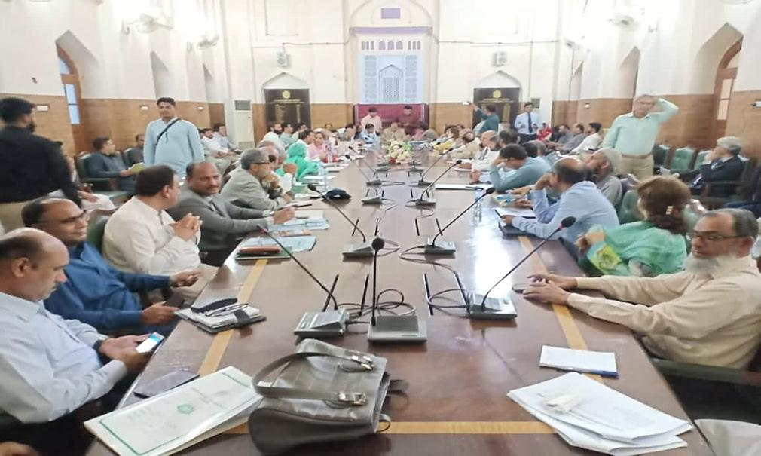
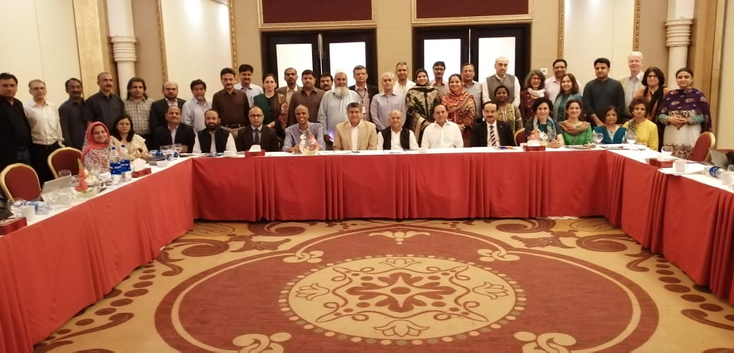
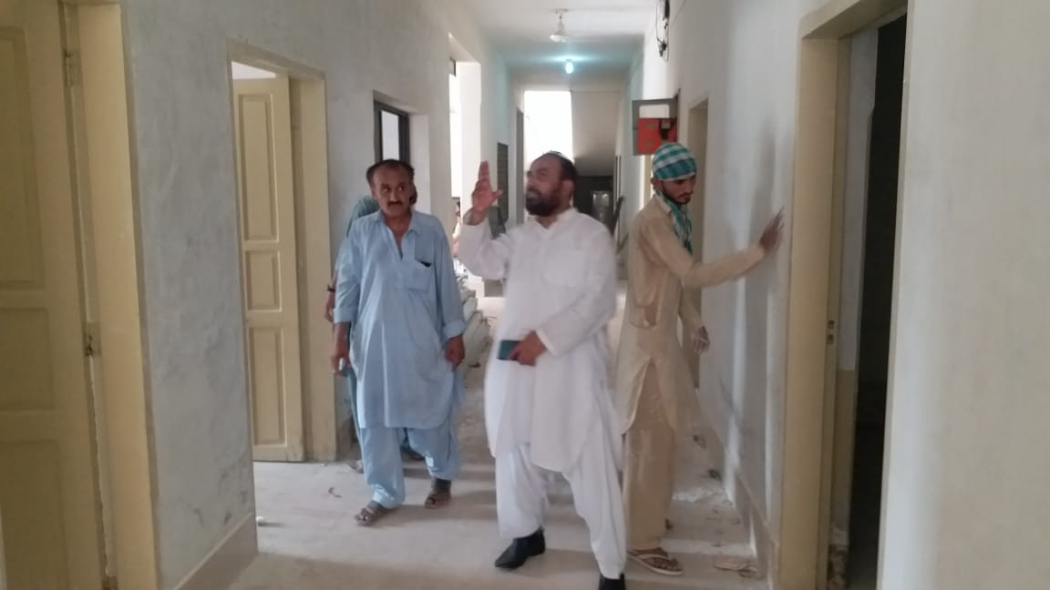
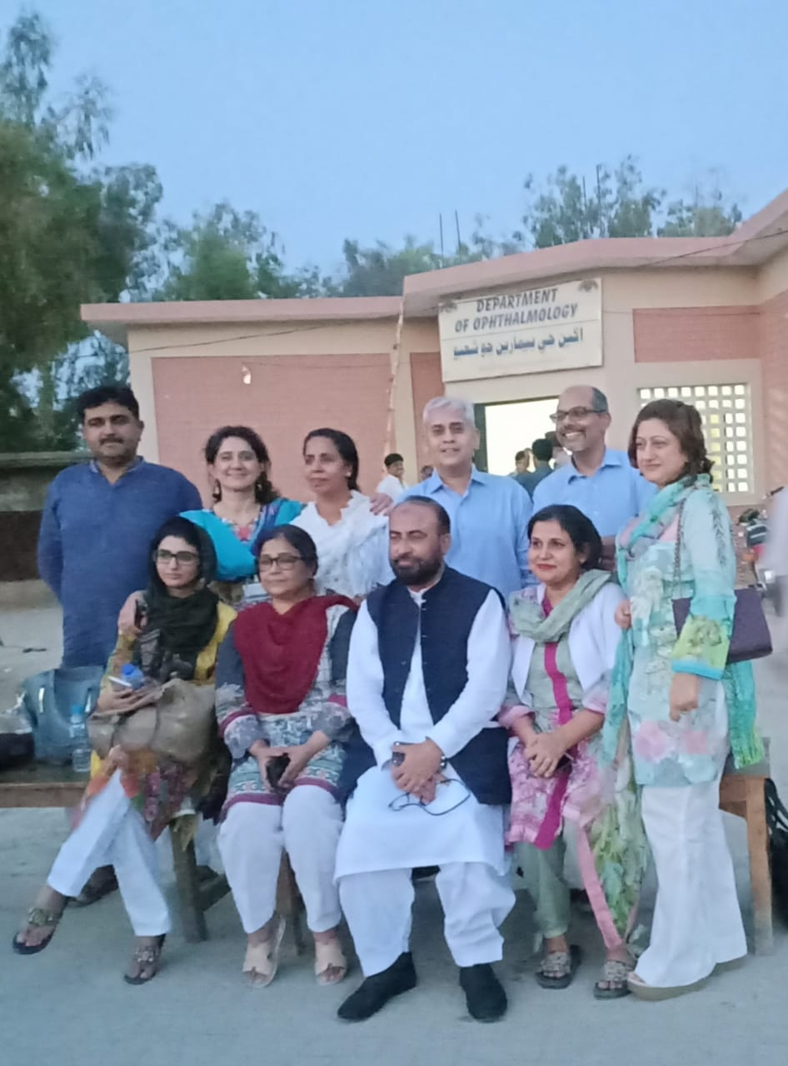
Snap Shot - Outbreak Response

Slide 21
Way Forward
Technical Working Groups (TWGs) notified with term of references
- Epidemiology
- Infection Prevention Control
- Treatment & Care
- Community Response
TWG for Resource Mobilization
- ADP Rs. 600 Million reserved for HIV / AIDS Program
- Endowment Fund of one billion through Chief Minister for
Rehabilitation of HIV +ve
Center of Excellence for HIV Treatment at Ratodero by end of July in support of multiple stakeholders

